Slide 1


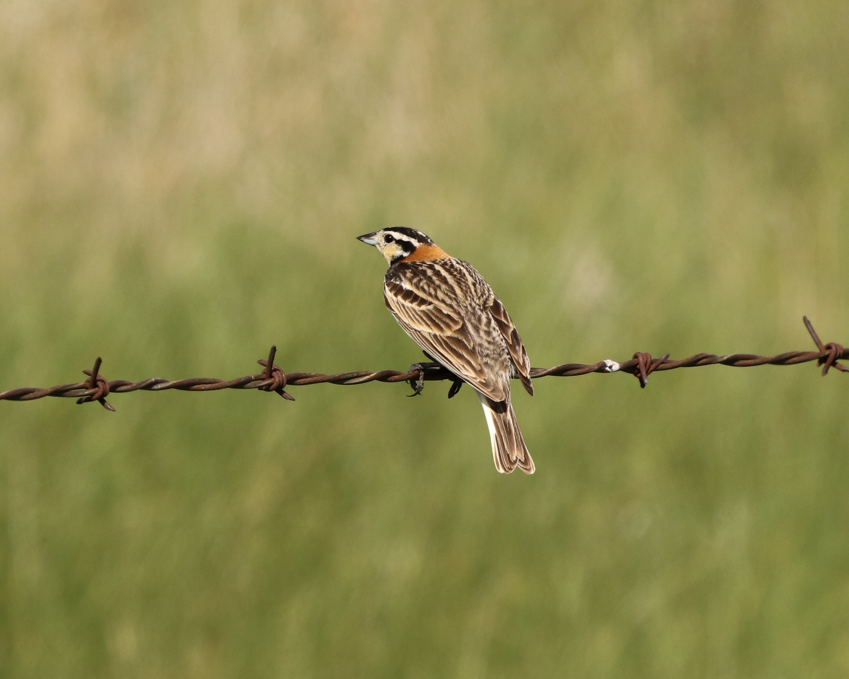
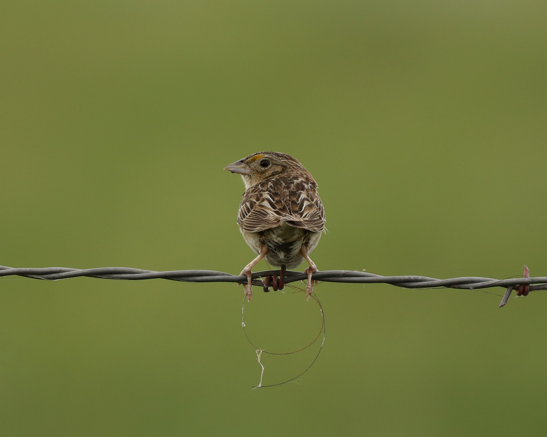
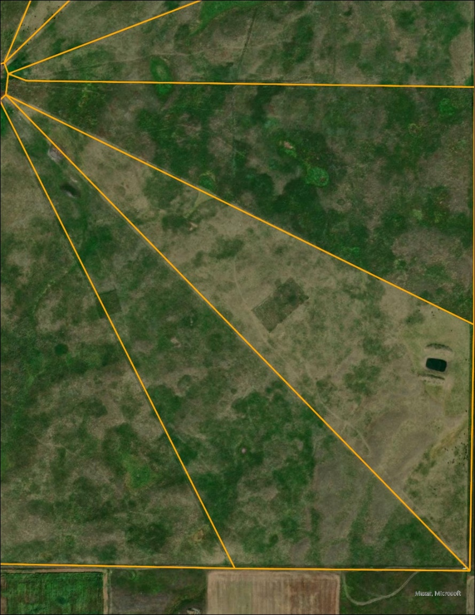
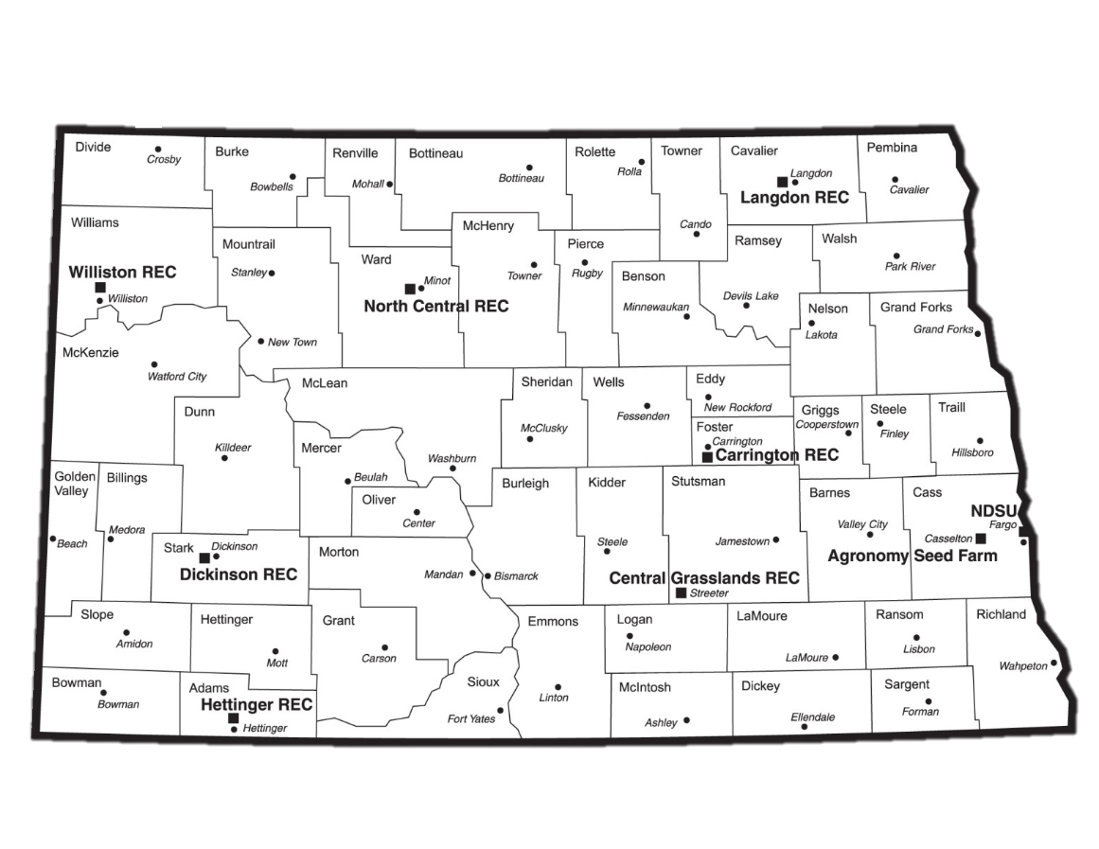
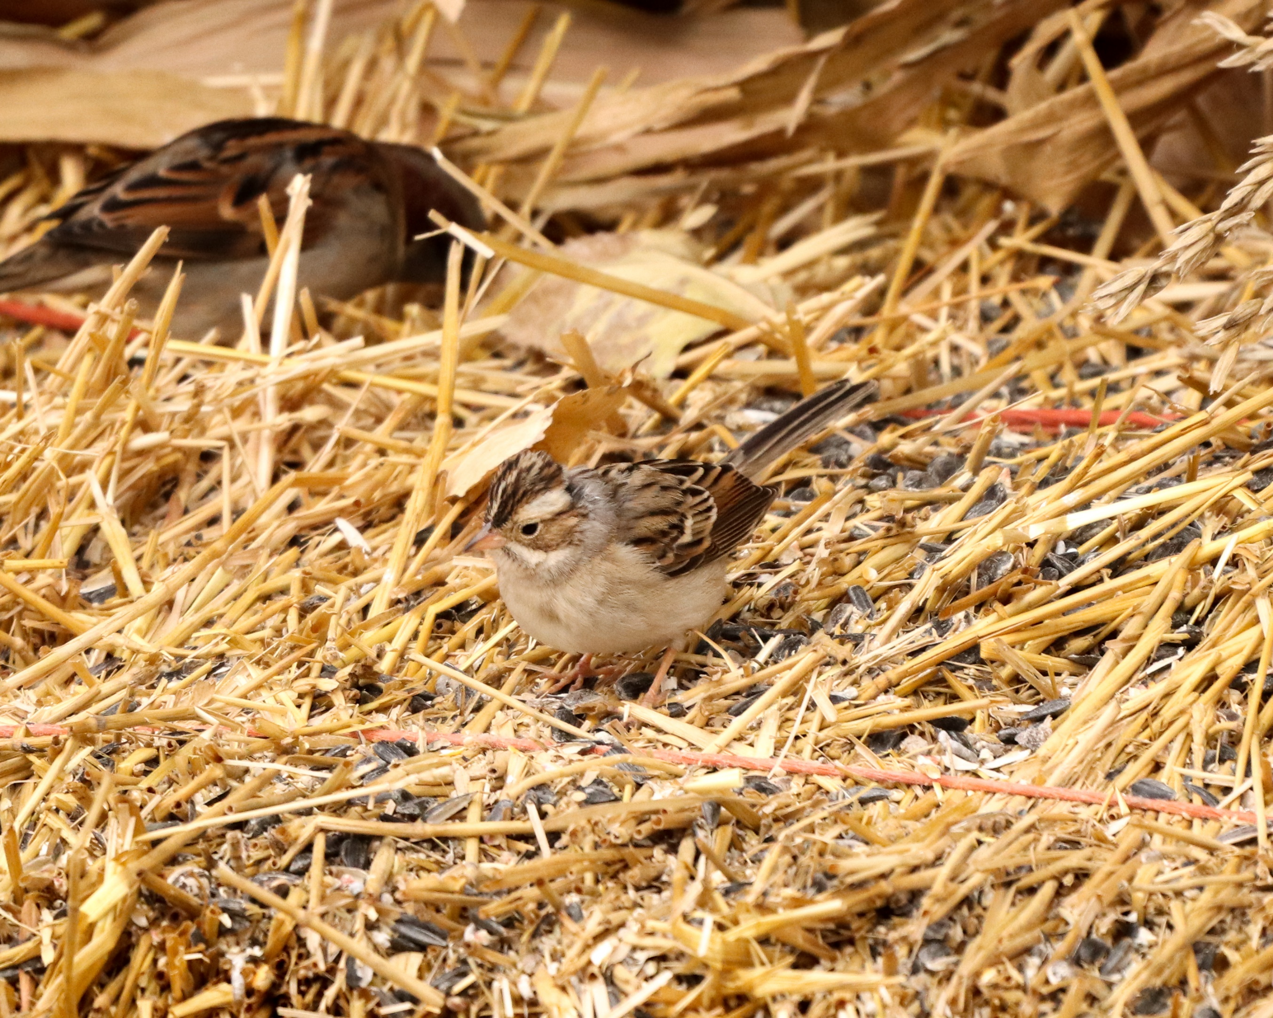

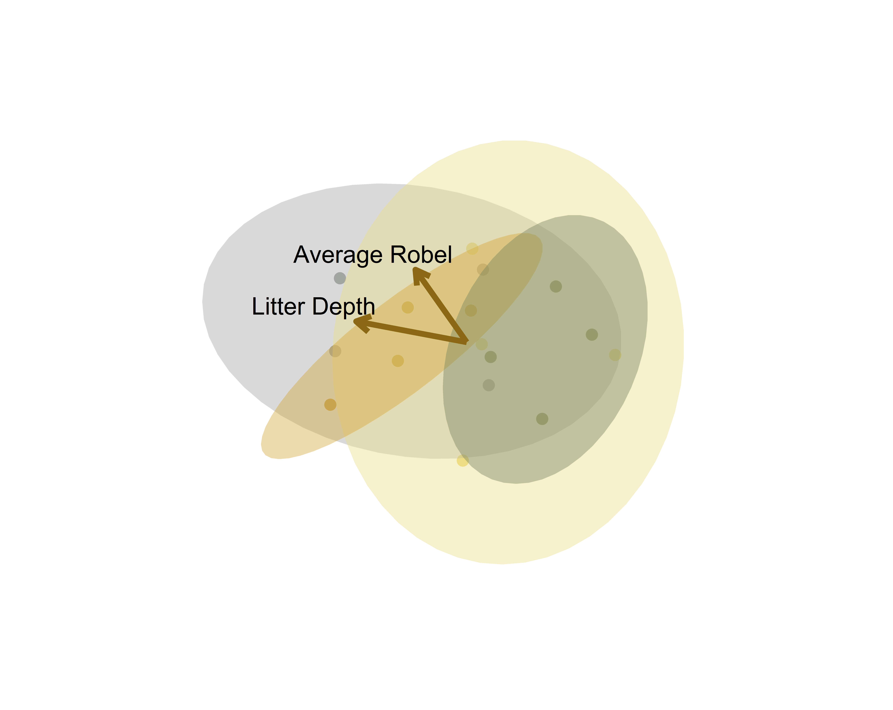
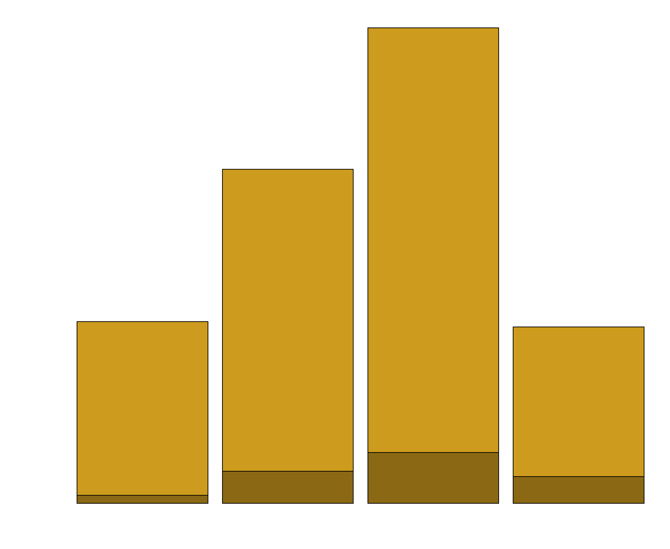
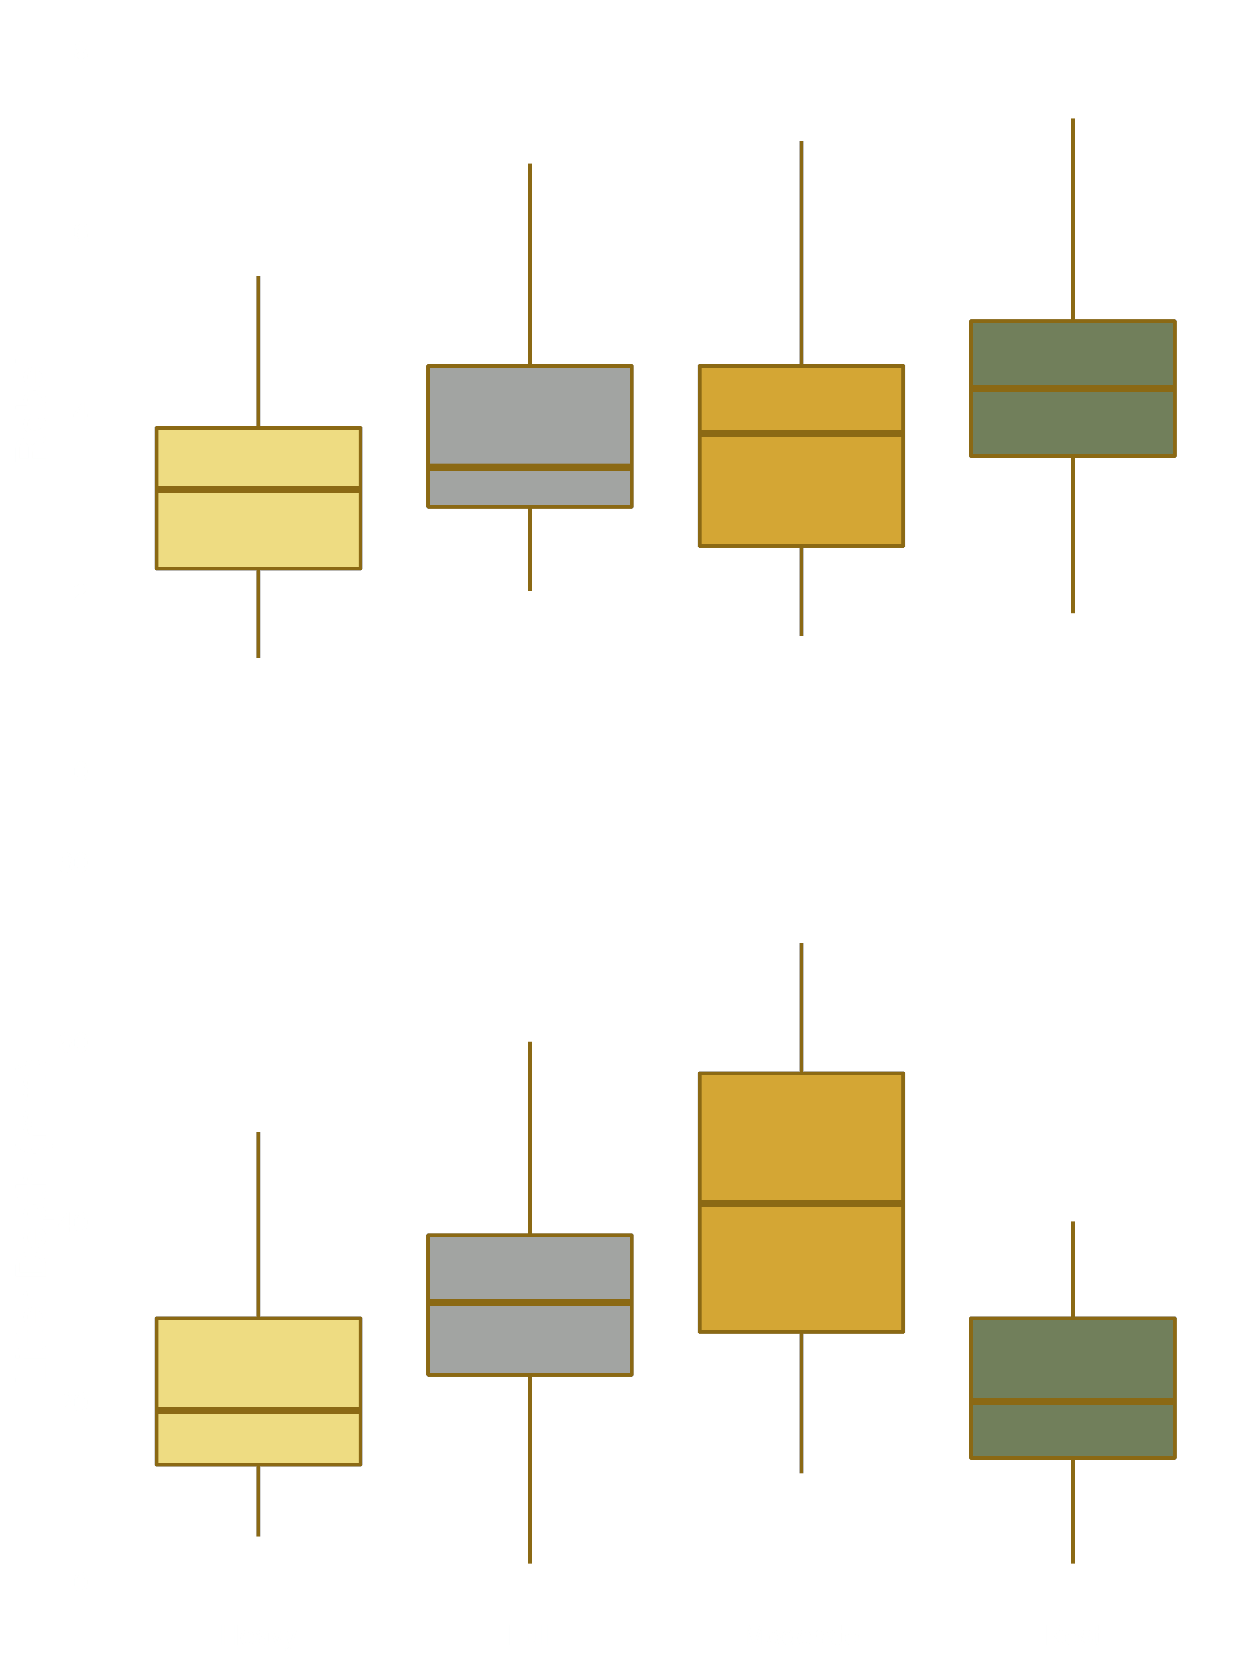
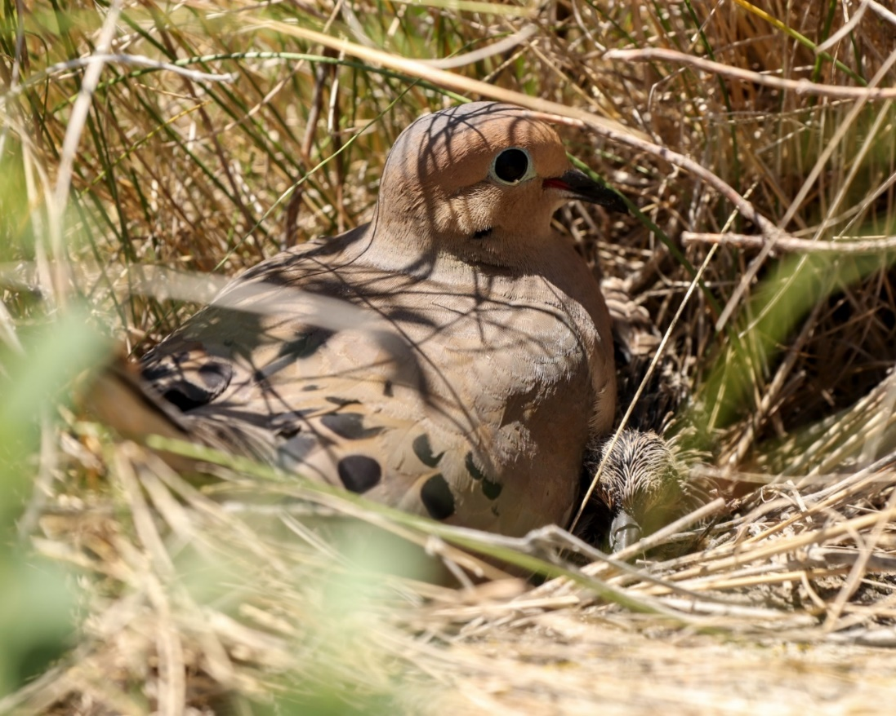


Breeding Bird Nesting Abundance and Nest Success in a Modified Twice-Over Rest-Rotation Grazing System
Justin Clarke¹, Torre Hovick¹, Kevin Sedivec^{1,2} , Ryan Limb¹, Jason Harmon¹, Ben Geaumont³
¹ School of Natural Resource Sciences, North Dakota State University, ² Central Grasslands Research Extension Center, ³ Hettinger Research Extension Center
BACKGROUND
Current grazing management in much of the Great Plains negatively influences avian diversity by creating homogenous landscapes through uniform grazing practices and altered or suppressed fire regimes.
Research has shown that restoring disturbance regimes can increase heterogeneity which increases avian biodiversity.
Fire and grazing interactions are effective at establishing heterogeneity, but many regions have a cultural aversion to fire which requires creative management practices to restore heterogeneity.
METHODS
Modified Twice-Over Rest-Rotation Grazing System
Pastures are divided into four paddocks based on utilization.
Rested (21 months of no grazing, 0% utilization)
Moderate Intensity (20-40% utilization)
Full Intensity (40-60% utilization)
Heavy Intensity (60+% utilization)
Stocking rates were maintained at ~2.76 AUM/ha.
Nest Dragging
We conducted nest drags from late-May to mid-July.
We used a 30 m rope with cans tied every 5 m.
We dragged each paddock 4 times.
Nest Monitoring
We monitored nests every 2-4 days until fate was determined.
Successful nests fledged at least one conspecific individual, determined by either resighting a fledging or using adult behavioral indicators.
We considered nests lacking these indicators as failures.
Vegetation Sampling
We measured vegetation structure along three 25 m transects in each paddock.
We took Robel readings in each cardinal direction.
We measured litter depth in each quadrat.
RESEARCH QUESTION
Can a modified twice-over rest-rotation grazing system create vegetation structural heterogeneity that benefits obligate grassland birds?
We found a total of 437 nests belonging to 24 different species including 8 obligate and 16 facultative grassland birds. Obligate grassland birds, species that use exclusively grasslands, accounted for 44 nests. Facultative grassland birds, species that use grasslands in conjunction with other ecosystems, accounted for the other 393 nests.
Avian Nesting Community
Avian Nesting Abundances
Heavy
FAC
Full
OBL
Moderate
Rest
The stacked bar plot shows the number of nesting individuals in each grazing intensity. Nesting species are divided up into facultative (FAC) and obligate (OBL) grassland birds based on habitat preference.
Vegetation Structure
The ordination compares avian nesting communities between grazing intensities where more distant points are more dissimilar. Ellipses show 95% confidence intervals. There was no significant difference in nesting communities between grazing intensities (PERMANOVA; p=0.07). Vegetation structural measurements are overlaid; longer arrows indicate factors that more strongly differentiates grazing intensities.
Grazing Intensity | Heavy | Full | Moderate | Rest
Proportion of Total Nests | 16% | 29% | 41% | 15%
Apparent Nesting Success | 22% | 26% | 30% | 26%
The table shows the proportion of the total nests and combined apparent nesting success for all species across each grazing intensity.
IMPLICATIONS AND FUTURE OBJECTIVES
Variation in grazing intensity alters vegetation structure and influences grassland bird nesting communities.
These results are preliminary and based on data collected during a period of extreme drought.
Research will continue for several years examining the impacts of a modified twice-over rest-rotation grazing system on nesting success.
Research will benefit obligate grassland nesting species that are currently listed as species of concern including grasshopper sparrow, chestnut-collared longspur, Northern pintail, upland sandpiper, and bobolink.
Contact Information
justin.r.clarke@ndsu.edu
Scan the QR code for references and additional information
The top figure shows Robel measurements for each grazing intensity. The bottom figure shows litter depth measurements in mm for each grazing intensity.

